Slide 2


Release Train
Permission API
ING-RC
(snapshot for refresh)
Release
Permission API
Trunk/Master/Develop
auto-cut
Production
(vNext)
Feature
vNext package
vNext package
Release Candidate (DYN-RC)
End User
Delivery Master (DYN-DM)
vNext package
Production release have Canary capability for safe release. No customer impact Blue/Green deployment, release during business hours. Quick roll back for any major issue.
Team Region (BIAB-100+)
vNext package
Release Candidate(RC) environment ensures regression test quality. It is the final gate to production.
Delivery Master (DM) environment allow us find integration issues early.
Source code branches - Feature, trunk, master, develop, release
Environments – BIAB, DYN-DM, DYN-RC, Prod
Code package – vNext package
Process – auto-cut
BIAB give us the physical environment to ensure parallel development has no impact to other squads.
Comprehensive code line management methodology enables massive parallel development
Engineer
2

Slide 3
What is Bank in a Box(BIAB)
Australia’s DevTest environment to enable massive parallel development, Australia has more than 60 development squads
Each BIAB has it’s own frontend applications, middleware applications, Core Banking, Databases and Domain Controller – full Bank
BIAB is a Hybrid Cloud Implementation – On-premise Data Centre + Azure
Australia has more than 120 BIAB

Slide 4
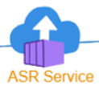
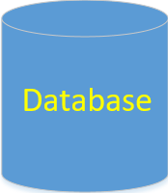
BIAB Environment
Hybrid Cloud
Frontend application, middleware applications, Core Banking and Databases – full Bank
Replication from On Premise Data Centre to Azure
On Premise Data Centre
About 60 VMs each BIAB
Total about 60 BIAB
Azure Public Cloud
About 60 VMs each BIAB
Total about 60 BIAB
4

Slide 5
Environment use case
Squad
Delivery Master(DM)
Release Candidate(RC)
Squad A Dev
Squad A Test
Delivery Master (DM)
Release Candidate (RC)
…
Squad X Dev
Multiple Squads Integration testing
Final regression testing before release
Squad X Test
Squad X signed off testing, ready for integration testing
5

Slide 6
Release Candidate Deployment and Gold Image
Gold Image is storage level of snapshot of Release Candidate(RC) environment that updated each week as part of release. This ensures Project environment we created based on latest Gold Image is up to date to Production.
Release Candidate(RC) Deployment include application releases, database changes as well as Operating System vulnerability patching.
6
6

Slide 7
BIAB creation process
Create from Gold image and thus always up to date to the latest production
Fully automated creation process – 30 minutes
Built-in environment smoke test

Slide 8
What is vNext and it’s Business value?
vNext is Australia’s Release Train scheduled to run weekly at a well defined time
Blue, Green deployment methodology, no customer impact release during business hours
Fast rollback in case of any major issue found post release
Canary capability for safe release
Comprehensive Observability Dashboard gives us full deep application status for informed decision making
Regression test for unknown application dependencies

Slide 9
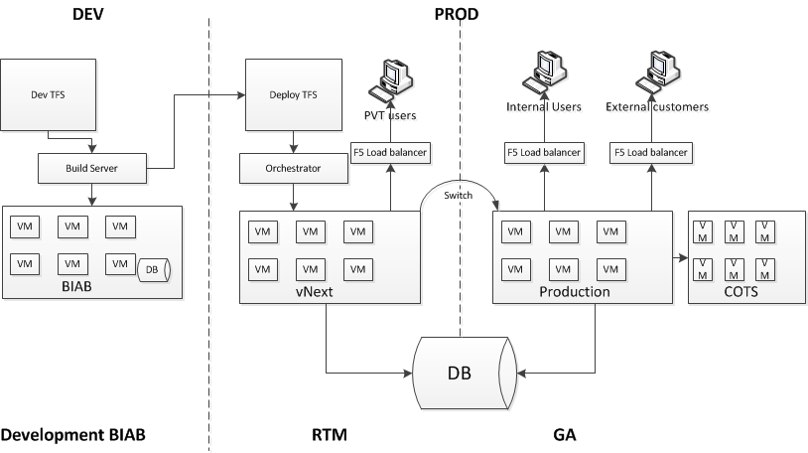
vNext process high level
New version of Bank(vNext) switched as Production version after PVT passed.
Going through multiple stages of BIAB test, including DM and RC, passed final regression test.
New version of the Bank(vNext) created in Production.
Application support team do final Production Verification Test(PVT).
Both Old and New version points to the same version of Database to ensure there’s no data lose.
Database backward compatible is the key design principle.

Slide 10
vNext switch – release to production
New Version
GA
Old Version
EXTWEB
DGW
BANCS
EXTWEB
EXTWEB
LIVE
MAPS
BATCH
BSL
STS
CARDS
LIVE
MAPS
BATCH
CARDS
BSL
STS
DGW
BANCS
LIVE
MAPS
BATCH
CARDS
BSL
STS
DGW
BANCS
BANCSBATCH
BANCSREPORTS
BANCSBATCH
BANCSREPORTS
BANCSBATCH
BANCSREPORTS
F5 Load balancer is used.
New version of 200+ applications will be add into GA pool.
The whole switch process takes about 30 minutes.
There’s no customer impact because we keep both Old and New version run concurrently for an hour before shutdown the old version.

Slide 11
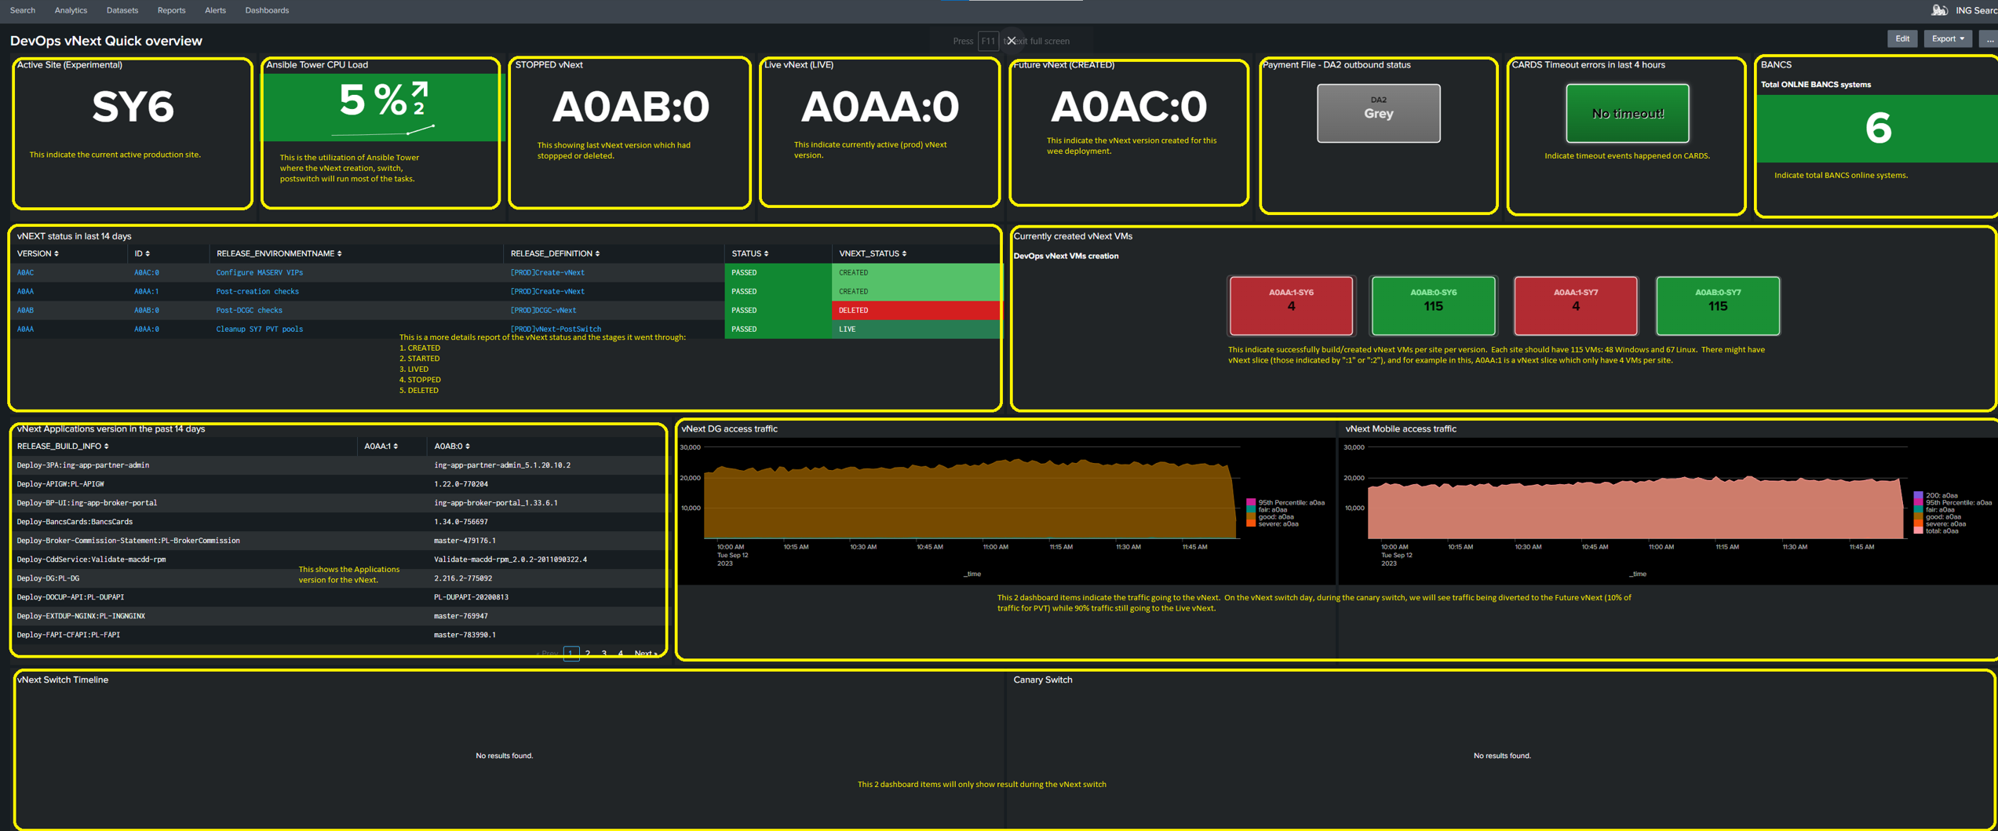
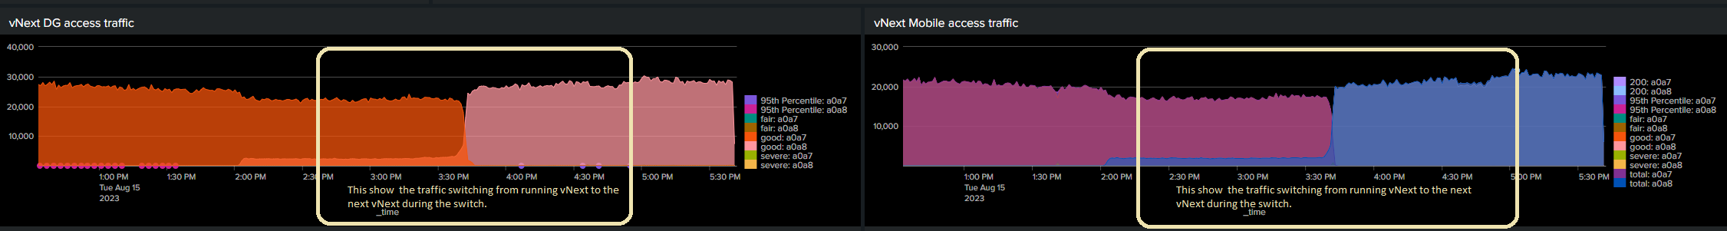
Observability dashboard for vNext infrastructure and application
Full visibility of vNext infrastructure, application status during Canary and Switch.

Slide 12
vNext rollback
Old Version
GA
New Version
EXTWEB
DGW
BANCS
EXTWEB
EXTWEB
LIVE
MAPS
BATCH
BSL
STS
CARDS
LIVE
MAPS
BATCH
CARDS
BSL
STS
DGW
BANCS
LIVE
MAPS
BATCH
CARDS
BSL
STS
DGW
BANCS
BANCSBATCH
BANCSREPORTS
BANCSBATCH
BANCSREPORTS
BANCSBATCH
BANCSREPORTS
Rollback is as simple as our release(switch) process. Just swap New and Old version.

Slide 13
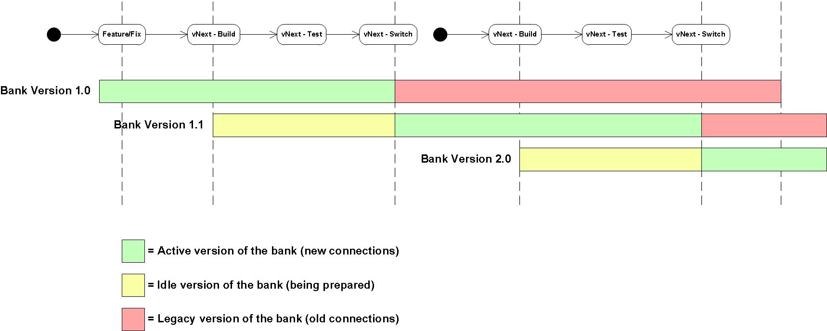
vNext release train schedule – weekly full bank release

Slide 14
vNext slice - express train 1
WEB
v
1
DG
v
1
vNext slice gives us capability for production emergency changes at application level.

Slide 15
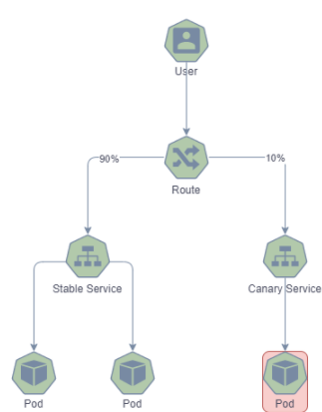
vNext express train 2 – Micro service application(MSA) release
2 sets of charts
Stable chart
Canary chart allow us release to x% customer before release to all customer – safe release
Application health is analyzed by the Engineer – self service
Approval process builtin for the Canary Rollback or Rollout to new version
Not time bounded
Controlled percentage traffic to canary version
All releases use Canary capability

Slide 16
TikTok – Data Centre Switching, Disaster Recovery (DR)
Process of moving all workloads from one datacenter to the other and diverting the customer traffic to the new data center
All external and internal links are diverted to the new data centre at the GTM level
Typically switch on a quarterly basis
TikTok is used for ING’s DR solution
TikTok solution is the backbone of Australia’s DR stage 6 maturity

Slide 17
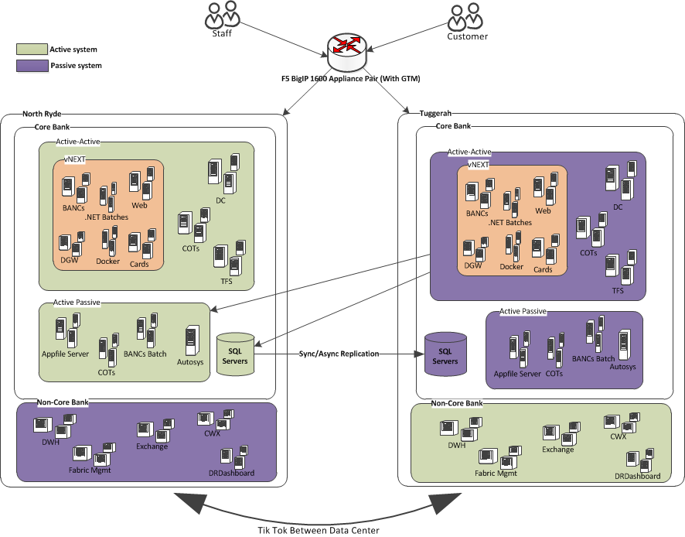
TikTok – Data Centre Switching, Disaster Recovery (DR)
SY6
SY7

